Slide 2
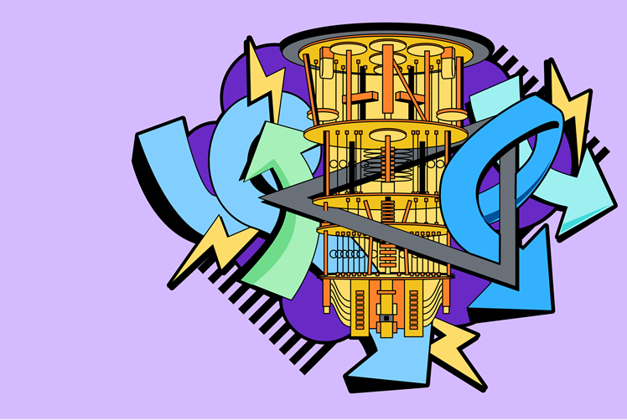
Intro to
Linear Algebra (cont.)
Vardaan Sahgal
IBM Qiskit Advocate
M.Sc. Physics, NSUT
Notes:
Today I will be continuing with some part of what was left in the previous lecture. A little more math to complete the fundamentals of quantum computing.

Slide 3
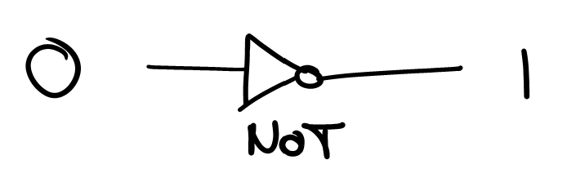
Gates & operators

Slide 4
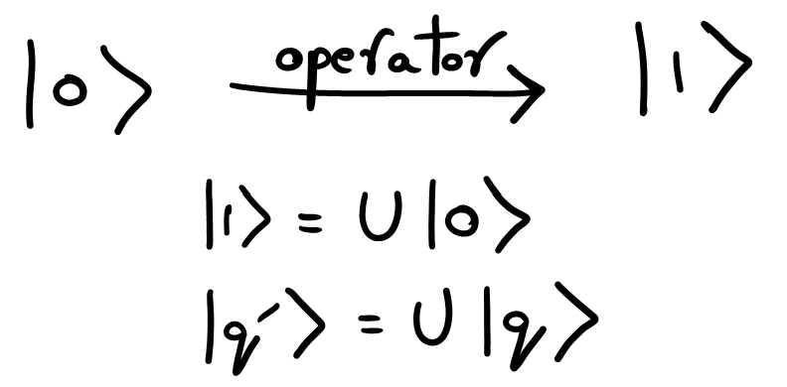
Gates & operators

Slide 5
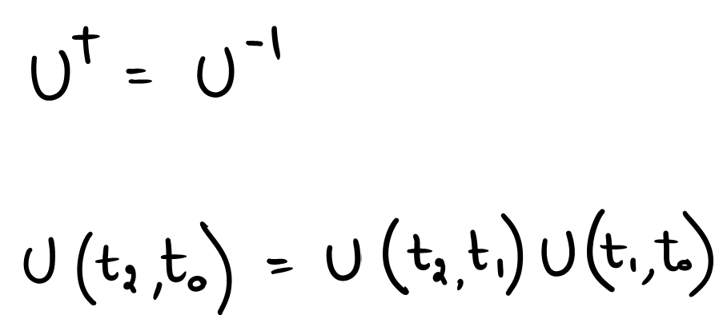
Gates & operators
All quantum gates (operators) are Unitary matrices.
All quantum gates are reversible.
Multiple quantum gates can be stacked one after the other by simple matrix multiplication.

Slide 6
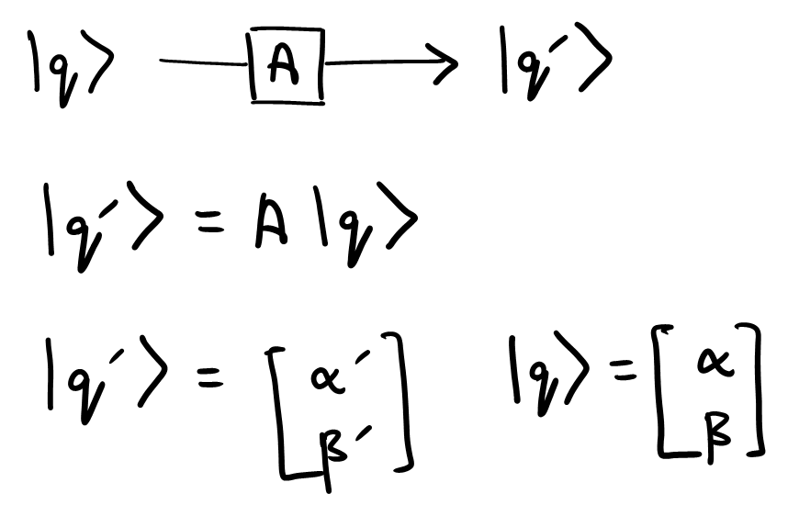
Gates & operators

Slide 7
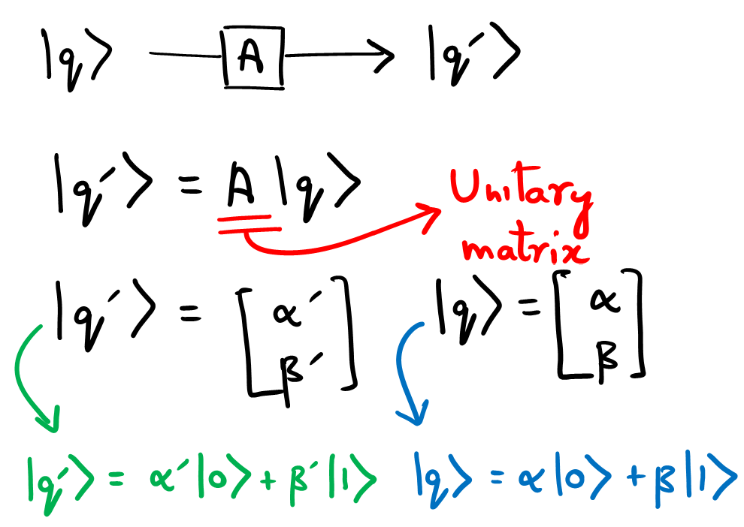
Gates & operators

Slide 8
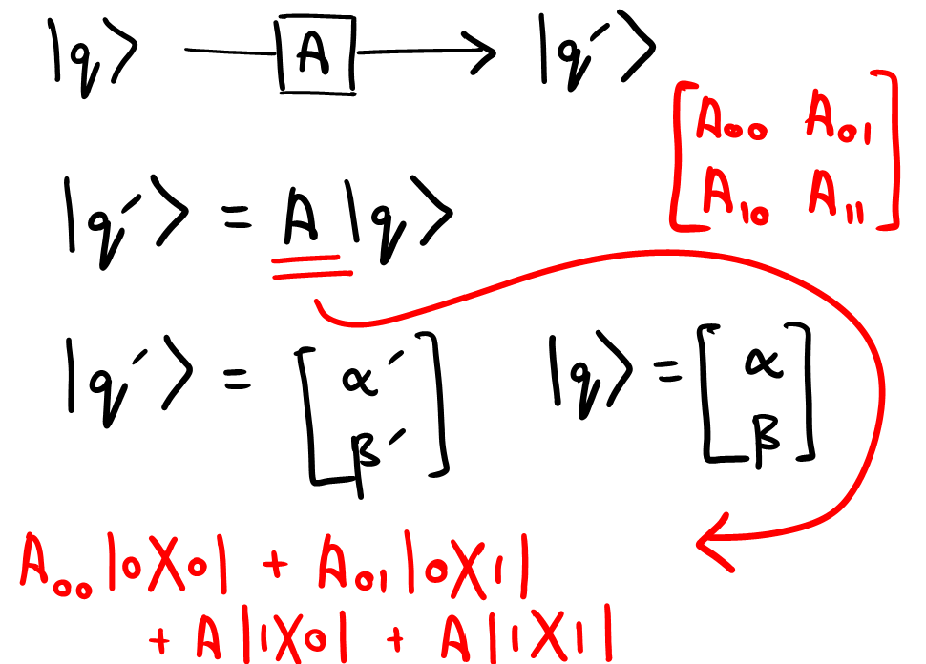
Gates & operators

Slide 9
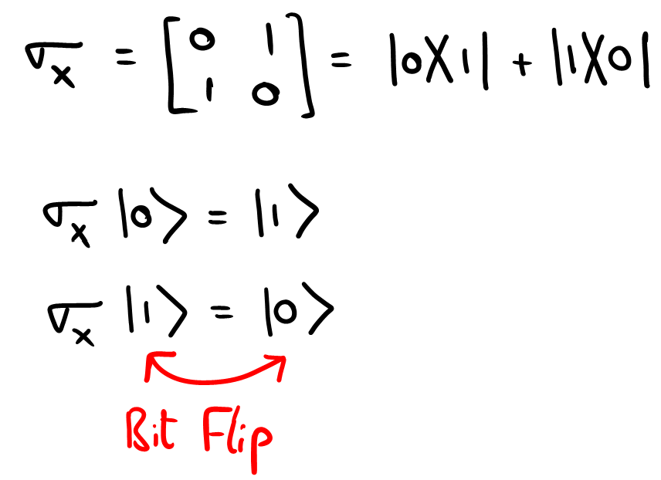
Single Qubit gate - Pauli X

Slide 10
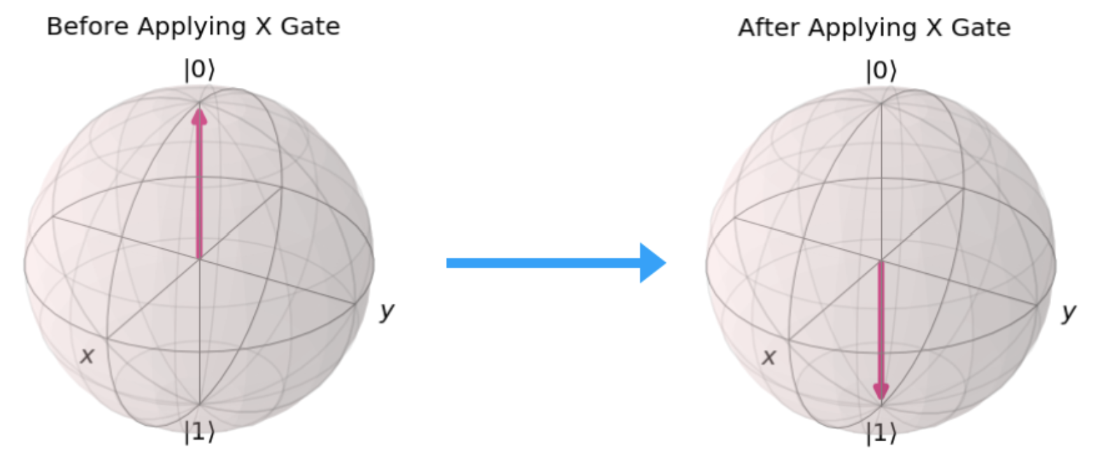
Single Qubit gate - Pauli X

Slide 11
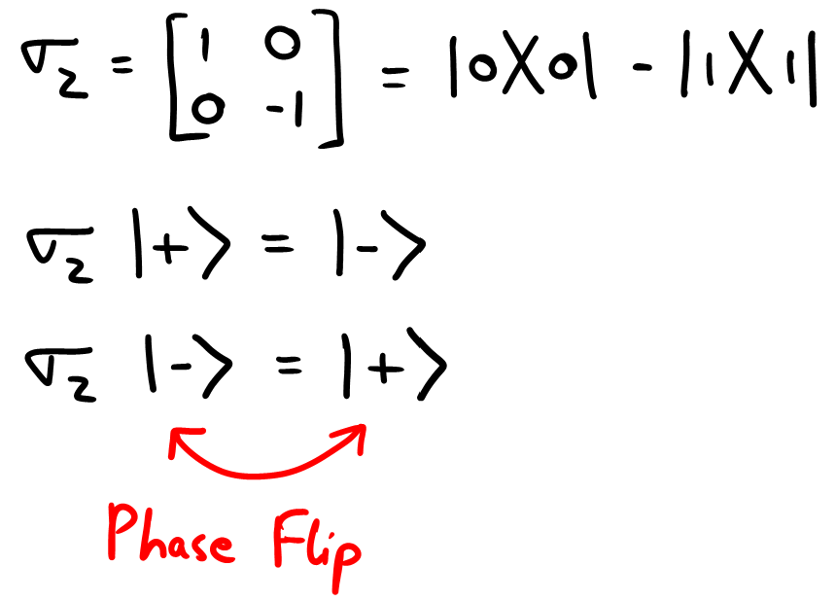
Single Qubit gate - Pauli Z

Slide 12
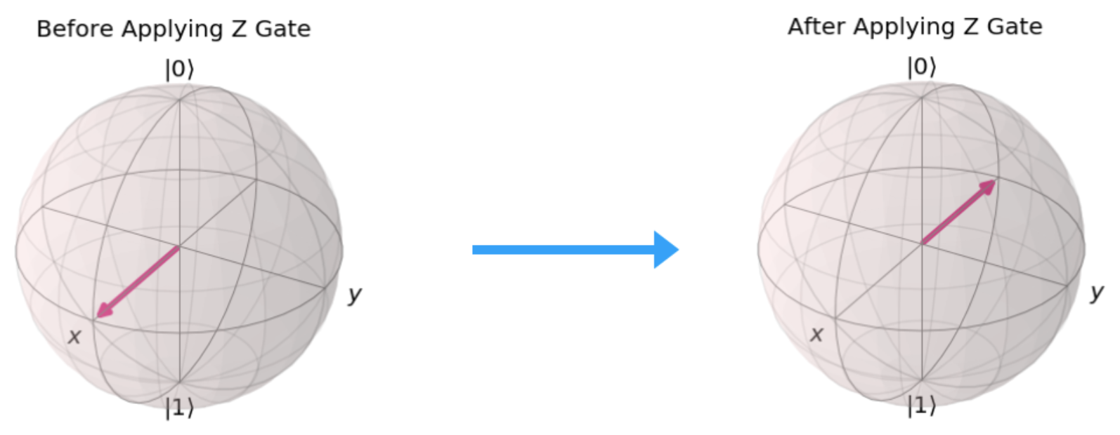
Single Qubit gate - Pauli Z

Slide 13
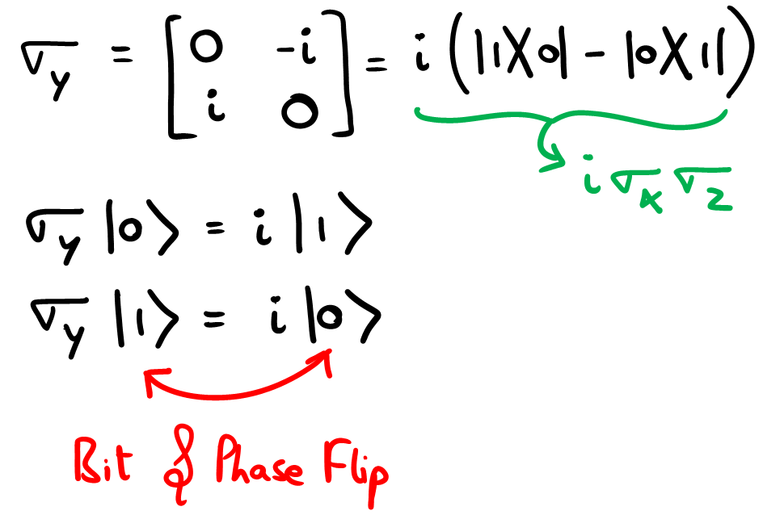
Single Qubit gate - Pauli Y

Slide 14
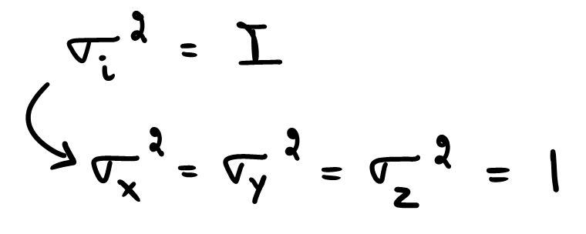
Pauli Gates - review
All Pauli gates are invertible.
Square of a Pauli gate is always unity.
To perform any single qubit rotation on a Bloch sphere, a combination of Pauli gates is sufficient.

Slide 15
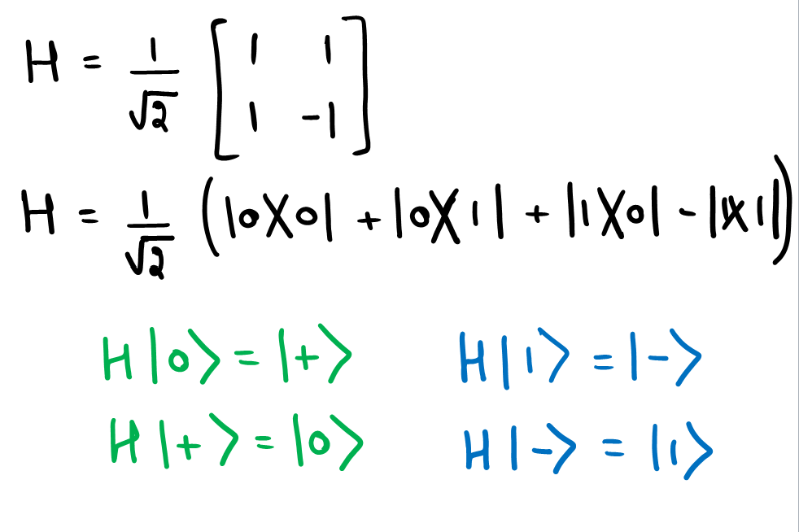
Single Qubit gate - Hadamard

Slide 16
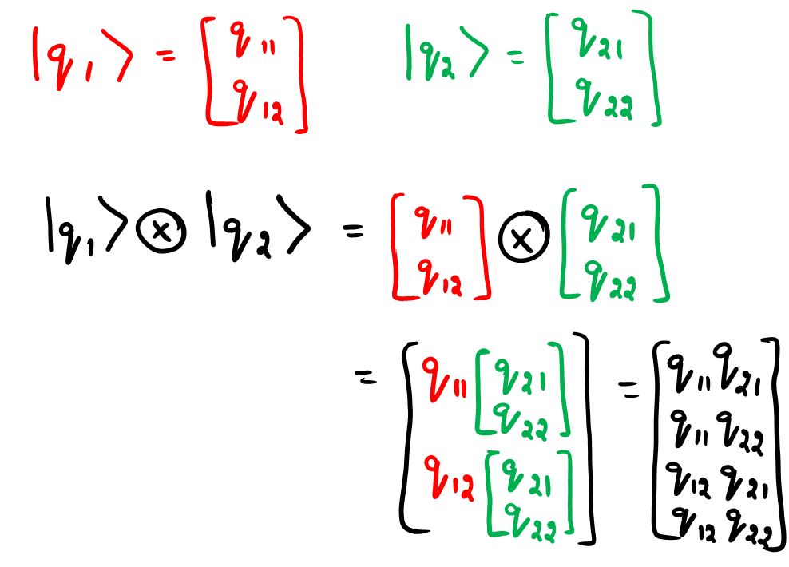
Tensor Product
With n qubits, we can represent 2^n states

Slide 17
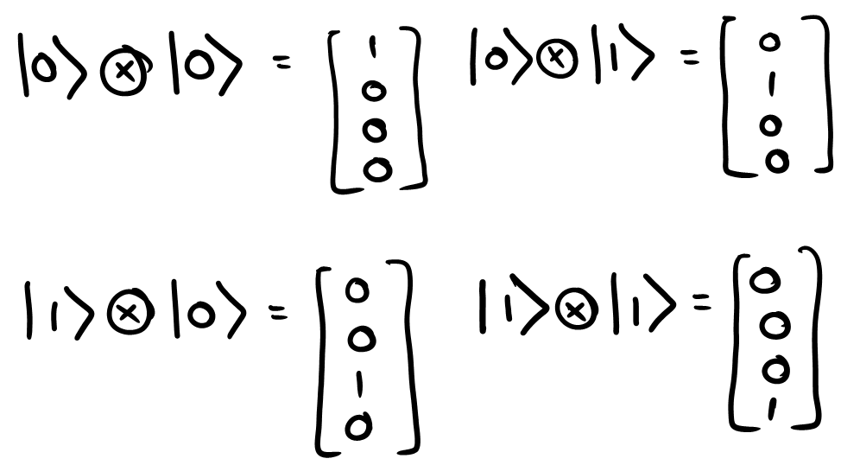
Tensor Product

Slide 18
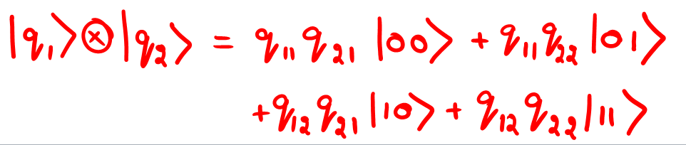
2-qubit state

Slide 19
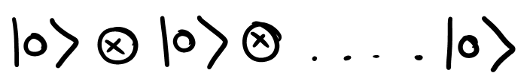
n-qubit state

Slide 20
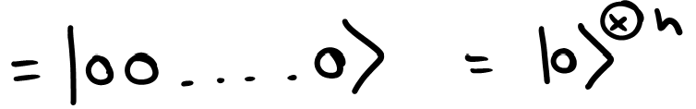
n-qubit state

Slide 21
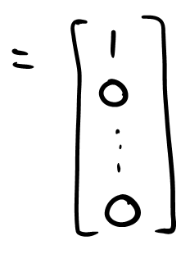
n-qubit state

Slide 22
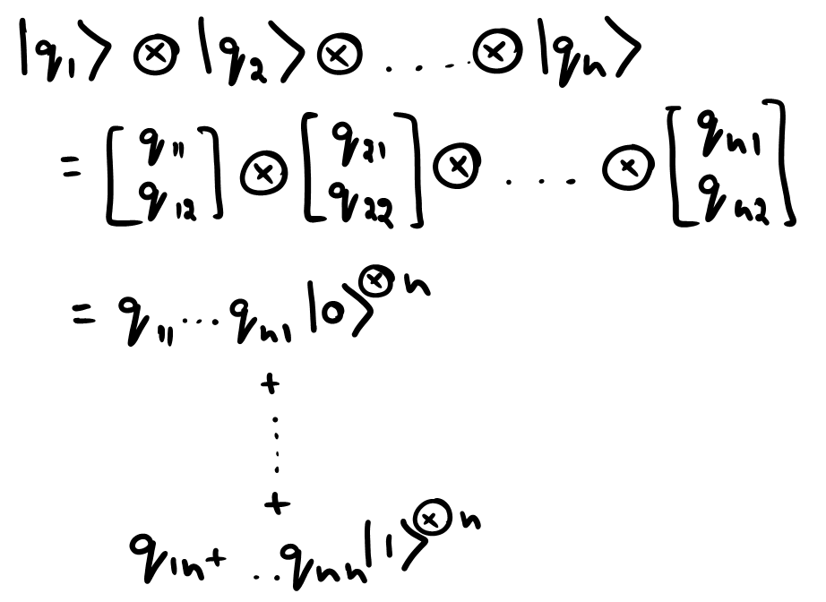
n-qubit state

Slide 23
Product & Entangled States
Product State: a state that can be expressed as a Tensor product of two states.
Entangled States: a state that can not be expressed as a Tensor product of two states.

Slide 24
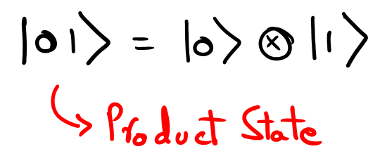
Product & Entangled States
Product State: a state that can be expressed as a Tensor product of two states.
Entangled States: a state that can not be expressed as a Tensor product of two states.

Slide 25
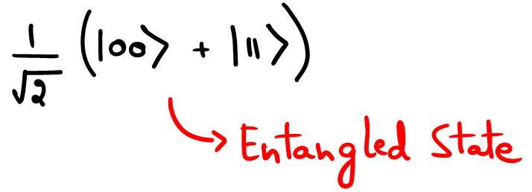
Product & Entangled States
Product State: a state that can be expressed as a Tensor product of two states.
Entangled States: a state that can not be expressed as a Tensor product of two states.

Slide 26
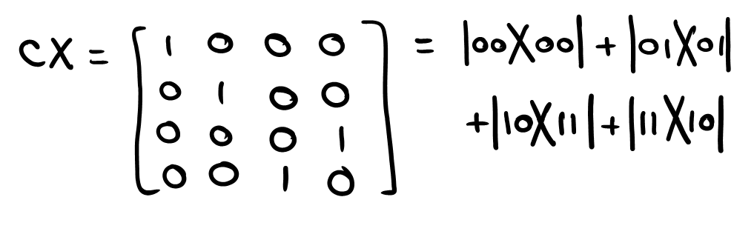
Multi Qubit gate - Controlled X

Slide 27
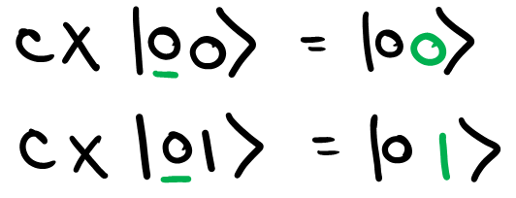
Multi Qubit gate - Controlled X

Slide 28
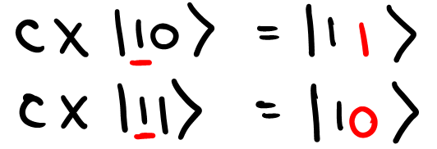
Multi Qubit gate - Controlled X

